Slide 1
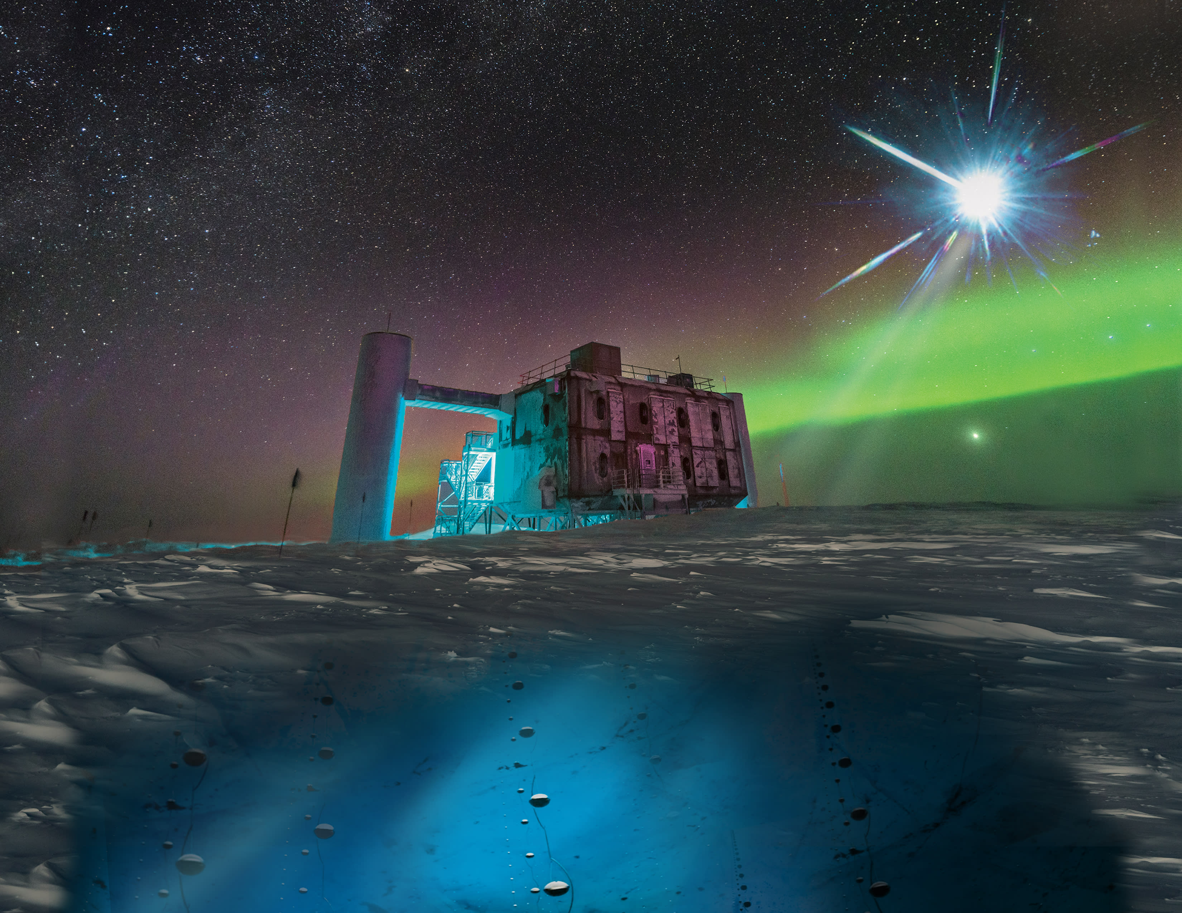
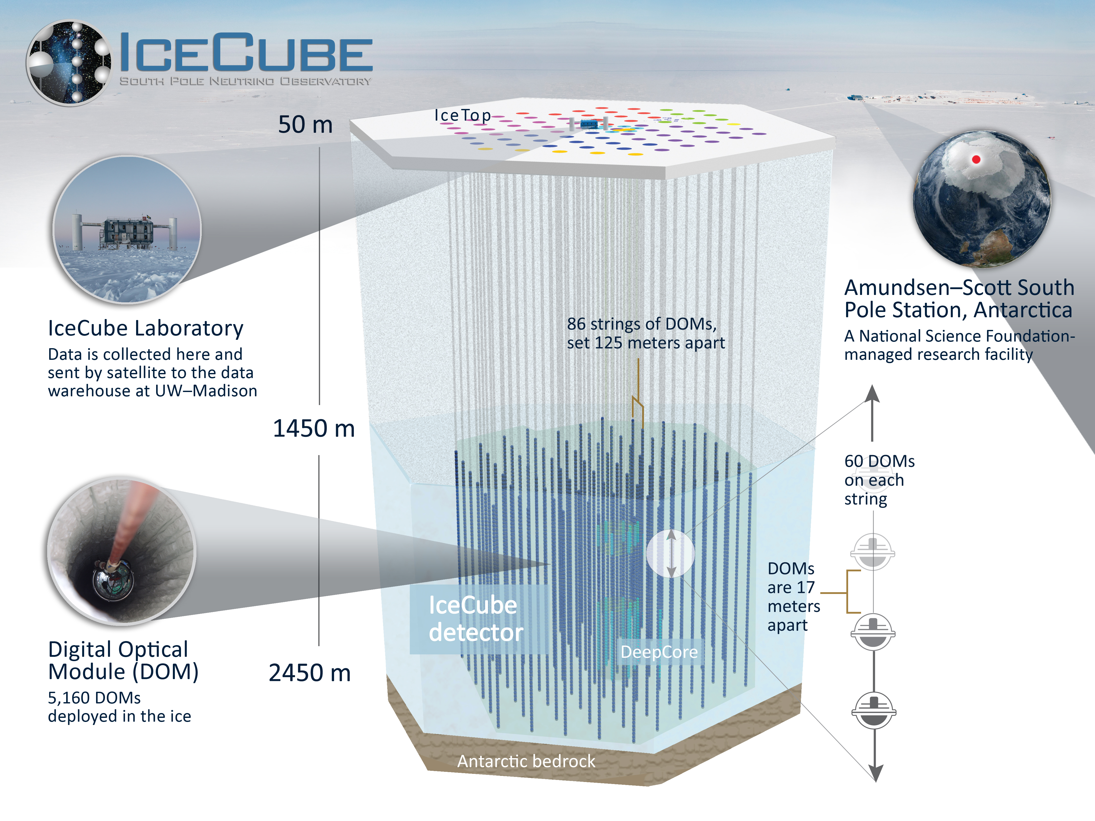
Project Proposal IceCube – Neutrinos in Deep Ice Eric Nguyen CIS4496
https://icecube.wisc.edu/gallery/in-science-icecube-neutrinos-point-to-long-sought-cosmic-ray-accelerator/
https://www.kaggle.com/competitions/icecube-neutrinos-in-deep-ice/overview/description

Slide 2
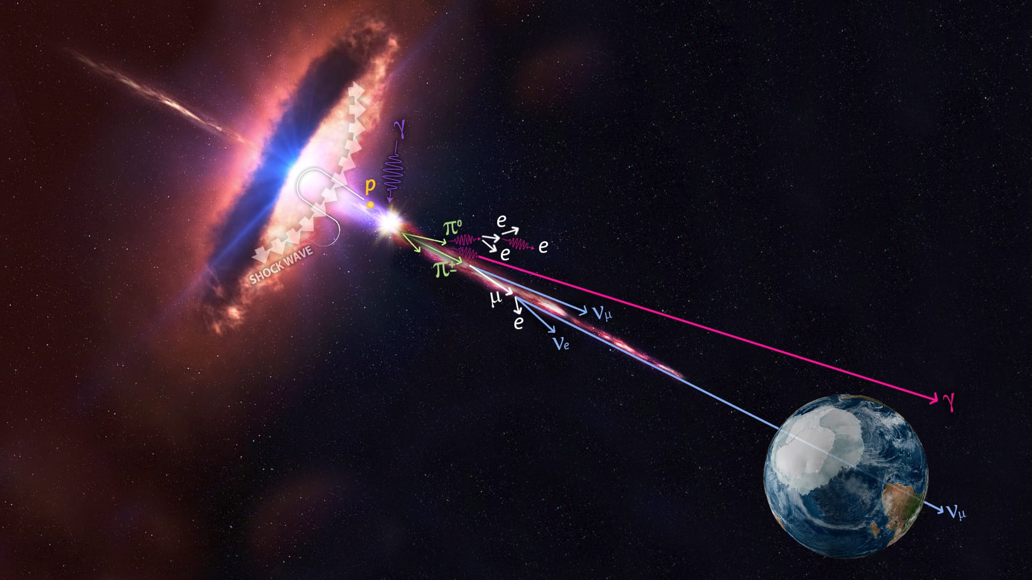
Problem
A blazar emitting neutrino particles towards Earth
https://icecube.wisc.edu/gallery/in-science-icecube-neutrinos-point-to-long-sought-cosmic-ray-accelerator/

Slide 3
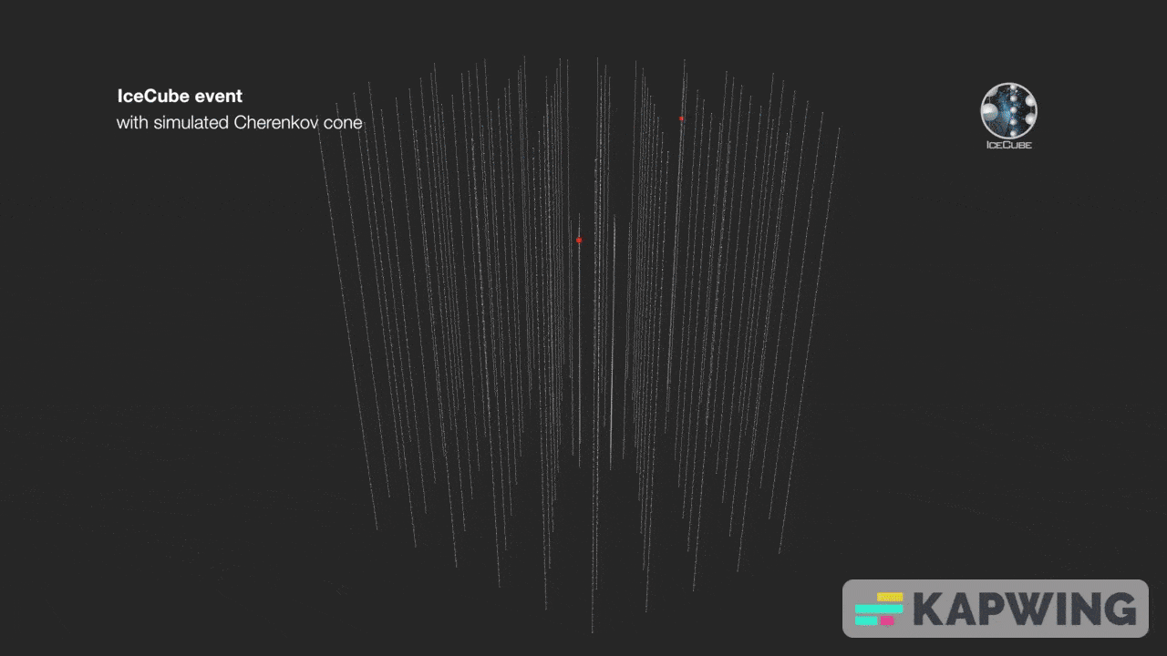
Objective
Predict neutrino direction
https://www.kaggle.com/code/dschettler8845/ndi-let-s-learn-together-eli5-and-eda

Slide 4
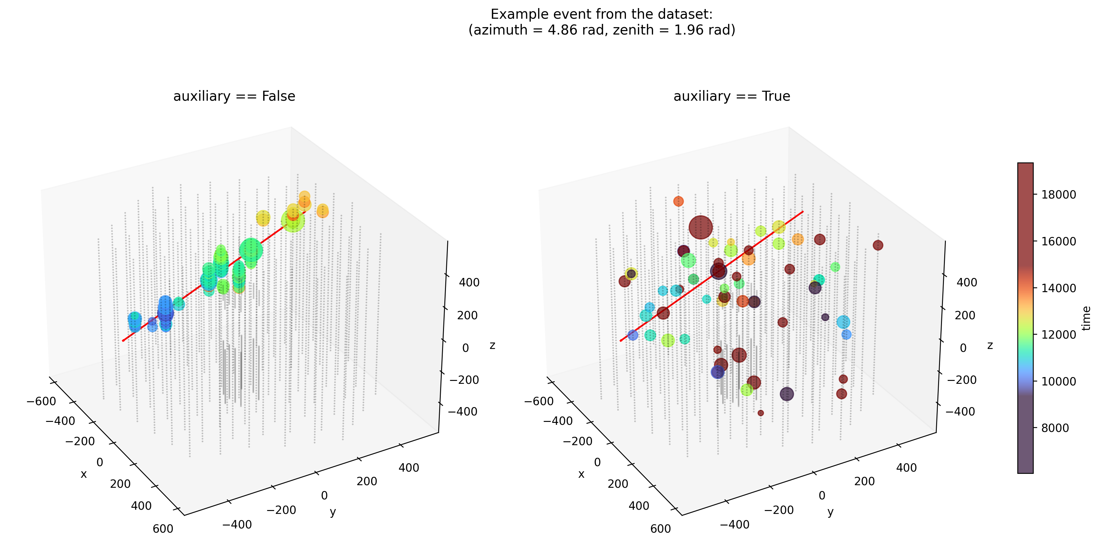
Nature of problem
Supervised learning problem (Regression)
https://www.kaggle.com/competitions/icecube-neutrinos-in-deep-ice/data

Slide 5
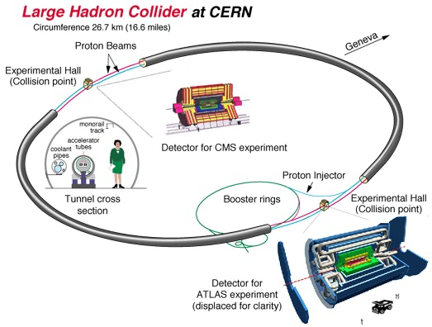
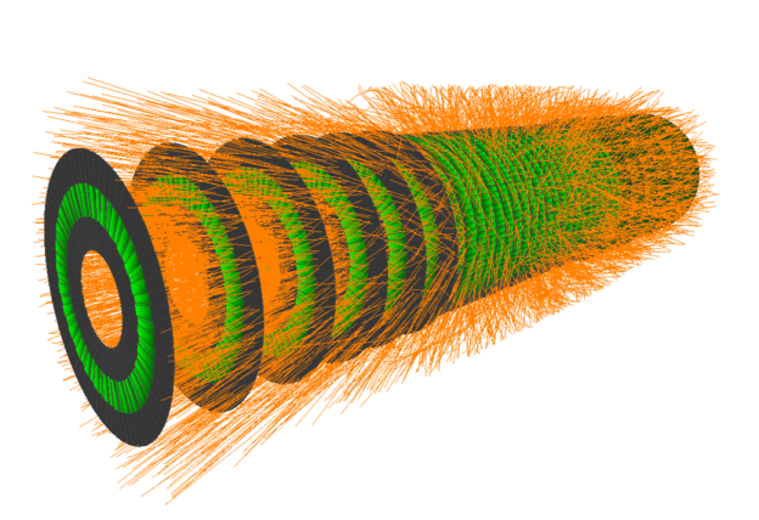
Past work
TrackML Particle Tracking Challenge
Problem
Quickly reconstruct particle tracks from 3D points left in silicon detectors
Context
Can machine learning help discover and characterize new particles?
Results
Speeds under 10s, faster than
state-of-the-art
https://www.nhn.ou.edu/~atlas/atlas/gluedispenser/presentation.html
https://www.kaggle.com/competitions/trackml-particle-identification/overview/description

Slide 6
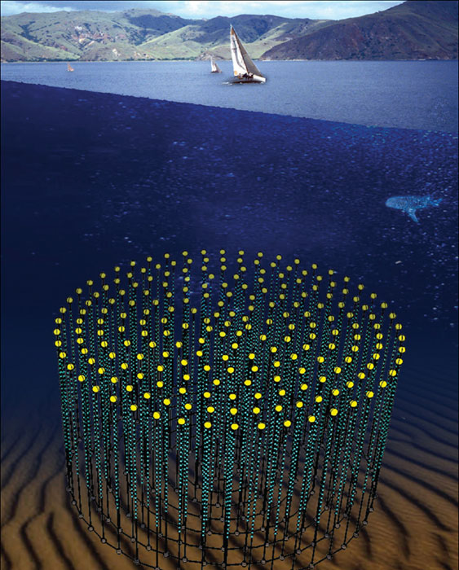
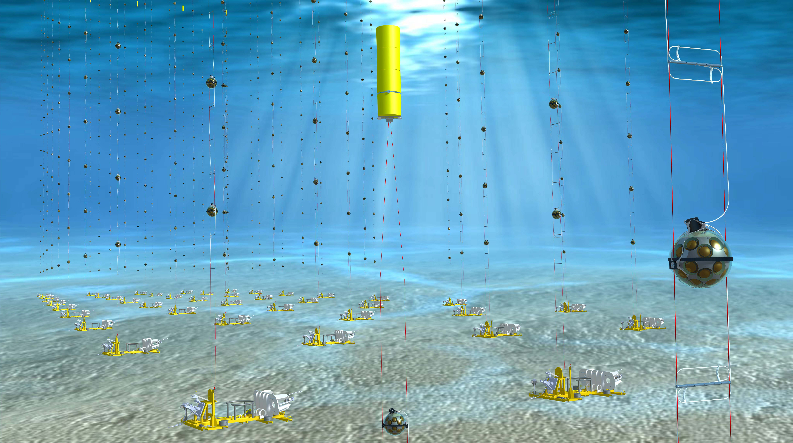
Proposed contributions
Documentation, reproducibility, and generalness
KM3NeT Neutrino Detector in Mediterranean Sea
https://www.km3net.org/pictures-and-videos/picture-galleries/album-artists-impressions/
https://cerncourier.com/a/a-neutrino-telescope-deep-in-the-mediterranean-sea/

